Slide 1

Paper Id: 1237 Improved Spam Email Filtering Architecture using Several Feature Extraction Techniques Priyo Ranjan Kundu Prosun, Kazi Saeed Alam, and Shovan Bhowmik Presenting Author: Shovan Bhowmik
International Conference on Big Data, IoT and Machine Learning (BIM 2021) Date: September 23-25, 2021

Slide 2
Outline
Introduction
Problem Statement
Literature Review
Research Questions
Objectives
Outcomes and Impacts
Methodology
Experimental Results
Conclusion
Future Research Direction
References

Slide 3
Introduction
Email services are amongst the most widely used communication tools because of their speed and effectiveness.
The virtues of email seem to be ruined by the widespread use of unpleasant, damaging, immoral, and deceptive email messages, which are frequently sent haphazardly by dishonest people who have no direct connection with the recipient.
Although knowledge engineering can detect spam emails, these are not fruitful since lots of rules need to be maintained. Therefore, the machine learning (ML) can along with natural language processing can play a vital role in this case.

Slide 4
Problem Statement
The overwhelming use of irritating, destructive, and misleading emails appears to have damaged the values of email.
The contents of spam emails can include commercials, online marketing, and scams including malware distribution, exposed data, and phishing.
People often become victim of fraudulent activities because of the underlying misleading information in these emails.

Slide 5
Literature Review
So far many research contributions are available regarding sentiment analysis.
Author | Work | Limitation
Mujtaba et al. [2017] | - Comparison between SVM, ANN, K-NN, Bayesian Classification was made. | No comparison between Feature extraction techniques
Chhabra et al.[2010] | - Non-Linear with specified kernel function was utilized for spam filtering on Enron Dataset. | - Ensemble based algorithms were not applied.
Rusland et al. [2018] | - Naïve Bayes based classification was devised on two benchmark datasets and precision, recall and F1-Score was calculated. | Majority voting was not introduced. Computational time was not considered.

Slide 6
Literature Review
So far many research contributions are available regarding sentiment analysis.
Author | Work | Limitation
Faris et al. [2019] | - Genetic Algorithm and Random Weight Network were employed to detect spams and achieved 96% accuracy. | NLP associated feature extraction was not examined.
Our Proposed Model | Performance: Two voting classifiers with ML and ensemble based algorithms for specific features in order to increase accuracy. Performance comparison with ML, ensemble and LSTM-CNN Hybrid. The highest 98% accuracy has been obtained. | Majority voting was not introduced. Computational time was not considered.

Slide 7
Research Questions
Can we devise a more efficient spam email filtering model with existing feature extraction techniques?
Can we give priority to all the algorithms while making a judgement?
Is this possible to achieve the performance of Deep learning algorithms with traditional ML algorithms with more computational time efficient way?

Slide 8
Objectives
To create voting models separately for specific type of machine learning algorithms.
To utilize various natural language feature extraction techniques.
To check whether majority voting models can reach deep learning algorithm performance or not.
To make a comparison between all the algorithms in spam filtering purpose.

Slide 9
Outcomes and Impacts
OUTCOMES:
We have constructed a model for spam filtering with faster training time and enhanced accuracy.
IMPACTS:
The implementation of the model in the end-to-end systems can filter out unauthentic and irrational emails.
More research scope can be created to devise context based opinion mining.

Slide 10
Methodology
Dataset Description:
For our work, we have used a benchmark dataset [Spam Assassin dataset] containing 15,736 emails with proper labeling.
Labeling categorizes all the existing emails into two groups- ‘Spam’ and ‘Ham’.
7850 (49.9%) are tagged as ‘Ham’(0) and the remaining 7886 (50.1%) emails are tagged as ‘Spam’.

Slide 11
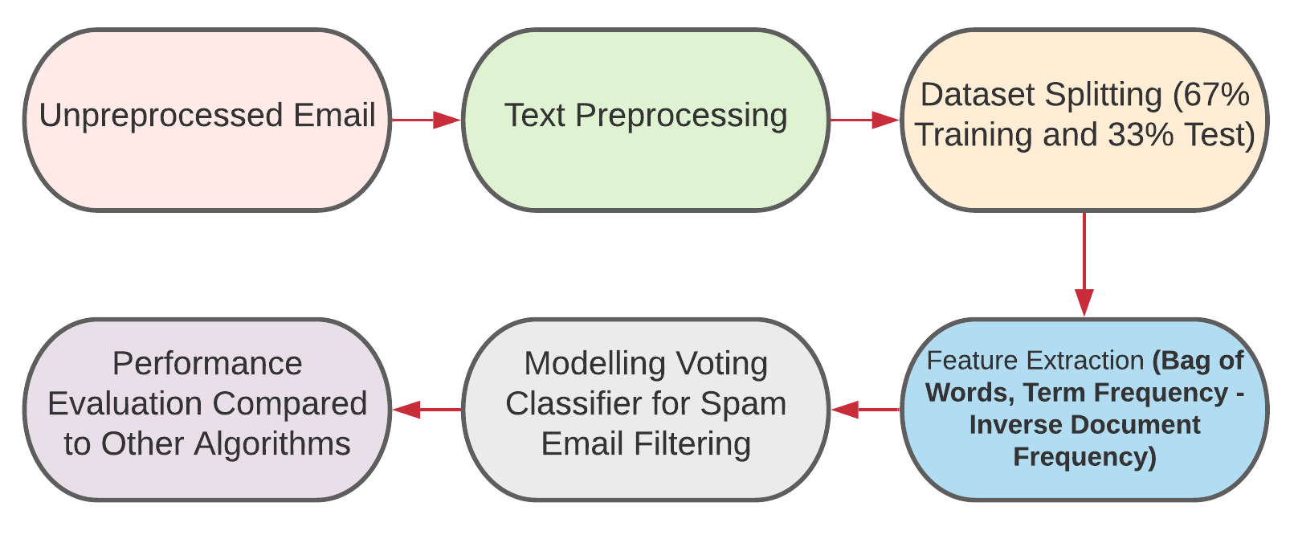
Methodology (Cont..)
Overall Workflow:
Improved Spam Email Filtering Architecture

Slide 12
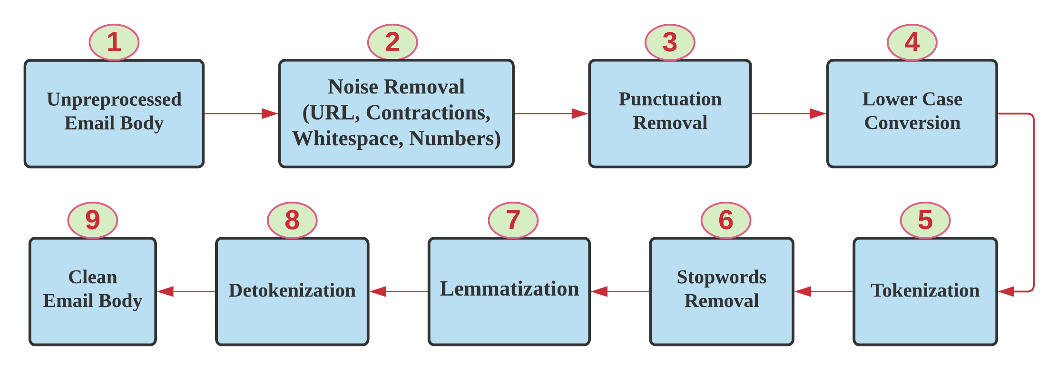
Methodology (Cont..)
Text Preprocessing:
Improved Spam Email Filtering Architecture

Slide 13
Methodology (Cont..)
Feature Extraction: One of the challenges of text categorization is learning from high dimensional data. Thus, it is best to perform feature reduction to reduce the text feature. Two different features selection methods are used:
Bag of Words (BoW): It takes each document as input and calculates the number of occurrences of each word in that article, which then generates a numerical representation of the text known as feature vectors of fixed length.
Term Frequency-Inverted Document Frequency (TF-IDF): It is a statistical metric used to measure how important a term is to a document in a dataset. It weights down the term frequency while scaling up the rare ones.
Improved Spam Email Filtering Architecture

Slide 14
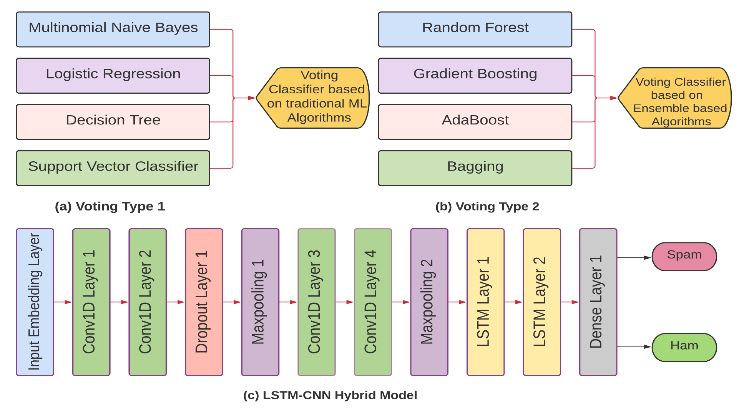
Methodology (Cont..)
Classification Process:
Improved Spam Email Filtering Architecture

Slide 15
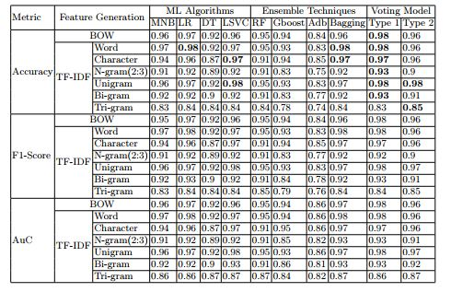
Experimental Results
Performance Comparison of various classifier models are given below:
Improved Spam Email Filtering Architecture

Slide 16
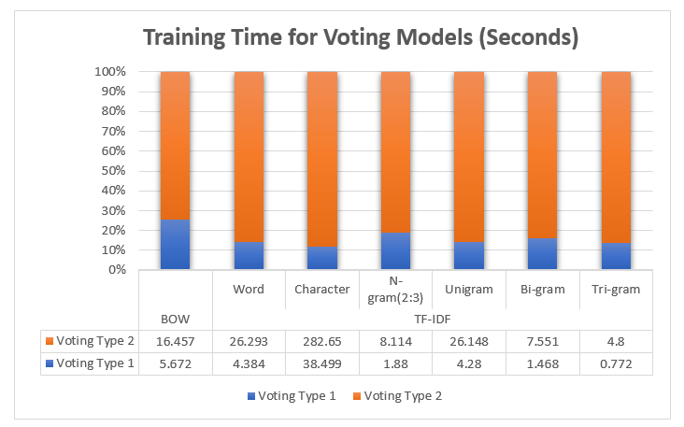

Experimental Results
Training Time Summary for Voting Models
Average model training time (seconds)
Improved Spam Email Filtering Architecture

Slide 17
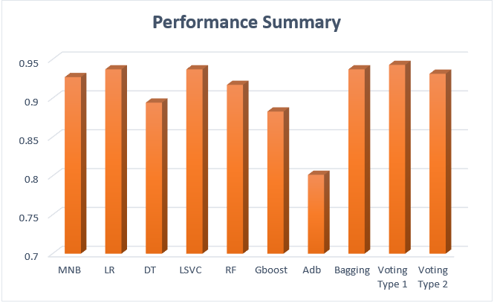
Experimental Results (Cont..)
Mean Accuracy of the ML models:
Improved Spam Email Filtering Architecture

Slide 18
Conclusion
Spam email messages continue to have an impact on people’s daily lives, whether deliberately or accidentally.
Our proposed voting classifier is designed with only Machine Learning algorithms for specific features in order to increase accuracy.
We have performed different N-Gram feature extraction for spam email classification.
The highest accuracy of 98% was achieved using the ML-based voting classifier using ‘Bag of Words’ as an extracted feature.
Improved Spam Email Filtering Architecture

Slide 19
Future Research Direction
More dataset can be utilized for the validation of the models.
Cross-validation can be applied.
‘Word-to-Vec’ and ‘Seq-to-Seq’ techniques can be incorporated.
It can be applied in other opinion mining tasks.
Improved Spam Email Filtering Architecture

Slide 20
References
1. Colladon, A. F., & Gloor, P. A. (2019). Measuring the impact of spammers on email and Twitter networks. International Journal of Information Management, 48, 254-262. 2. Guzella, T. S., & Caminhas, W. M. (2009). A review of machine learning approaches to spam filtering. Expert Systems with Applications, 36(7), 10206-10222. 3. Awad, W. A., & ELseuofi, S. M. (2011). Machine learning methods for spam e-mail classification. International Journal of Computer Science & Information Technology (IJCSIT), 3(1), 173-184. 4. Saeedian, M. F., & Beigy, H. (2012). Learning to filter spam emails: An ensemble learning approach. International Journal of Hybrid Intelligent Systems, 9(1), 27-43. 5. Saab, S. A., Mitri, N., & Awad, M. (2014, April). Ham or spam? A comparative study for some content-based classification algorithms for email filtering. In MELECON 2014-2014 17th IEEE Mediterranean Electrotechnical Conference (pp. 339-343). IEEE. 6. G. Mujtaba, L. Shuib, R. G. Raj, N. Majeed and M. A. Al-Garadi, \Email classification research trends: review and open issues", IEEE Access, 2017, 5, 9044-9064. 7. P. Chhabra, R. Wadhvani and S. Shukla, \Spam filtering using support vector machine", International Journal of Computer & Communication Technology, 2010, 1(2), 322-341. 8. Rusland, N. F., Wahid, N., Kasim, S., & Hafit, H. (2017, August). Analysis of Naive Bayes algorithm for email spam filtering across multiple datasets. In IOP conference series: materials science and engineering (Vol. 226, No. 1, p. 012091). IOP Publishing. 9. Barushka, A., & Hajek, P. (2018). Spam filtering using integrated distributionbased balancing approach and regularized deep neural networks. Applied Intelligence, 48(10), 3538-3556. 10. Bahgat, E. M., Rady, S., Gad, W., & Moawad, I. F. (2018). Efficient email classification approach based on semantic methods. Ain Shams Engineering Journal, 9(4), 3259-3269.

Slide 21
References (Cont..)
11. Faris, H., Ala’M, A. Z., Heidari, A. A., Aljarah, I., Mafarja, M., Hassonah, M. A., & Fujita, H. (2019). An intelligent system for spam detection and identification of the most relevant features based on evolutionary random weight networks. Information Fusion, 48, 67-83. 12. Ruano-Ordas, D., Fdez-Riverola, F., & M´endez, J. R. (2018). Concept drift in email datasets: An empirical study with practical implications. Information Sciences, 428, 120-135. 13. https://www.kaggle.com/nitishabharathi/email-spam-dataset 14. Alam, K. S., Bhowmik, S., & Prosun, P. R. K. (2021, February). Cyberbullying Detection: An Ensemble Based Machine Learning Approach. In 2021 Third International Conference on Intelligent Communication Technologies and Virtual Mobile Networks (ICICV) (pp. 710-715). IEEE. 15. Bhowmik, S., Prosun, P. R. K., & Alam, K. S. (2021). A Novel Three-Level Voting Model for Detecting Misleading Information on COVID-19. Paper presented at the 6th International Conference on Emerging Applications of Information Technology (EAIT) Kolkata, India. 16. Ajao, O., Bhowmik, D., & Zargari, S. (2018, July). Fake news identification on twitter with hybrid cnn and rnn models. In Proceedings of the 9th international conference on social media and society (pp. 226-230).

Slide 22
Thank You

